Slide 2
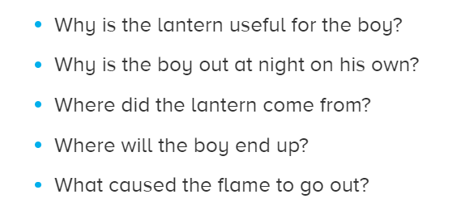
Questions to help you with ideas

Slide 3
