Slide 1
Phonics Screening Check 2023
Information for Parents and Carers

Slide 2
What is the phonics screening check?
The phonics screening check is a short assessment to check if individual children have learnt phonic decoding to an appropriate standard. This is one way the children learn to read.
The check consists of 40 words, 20 real words and 20 pseudo-words that your child will be asked to read one-to-one with a teacher.
It helps to identify the children who need extra help so they are given support by their school to improve their reading skills.

Slide 3
Who is it for?
The screening check is for all Year 1 pupils and children in Year 2 who previously did not meet the standard of the check in Year 1.
Is it compulsory?
It is a statutory requirement for all schools to carry out the screening check.
Do children with Special Education Needs have to take the screening check?
It should be taken by as many children as possible, and the Government have worked closely with SEN specialists to make this happen.

Slide 4
When does the Phonics Check happen?
The phonics screening check takes place in June of each year.
This year, the screening checks begin on
Monday 12th June 2023.

Slide 5
How is the check structured?
It will be a short, simple screening check to make sure that all children have grasped basic phonic skills.
It is made up of a list of 40 words and non-words, which a child will read one-to-one with a teacher. Half of the words cover phonic skills which tend to be covered in Reception, and half of the words are based on Year 1 phonic skills.
The check will contain a mix of real words and ‘alien words’ (nonsense words). Your child will be told before the check that there will be alien words that he or she has not seen before.
We use ‘alien words’ when we teach phonics, so your child should be know what to look out for.

Slide 6
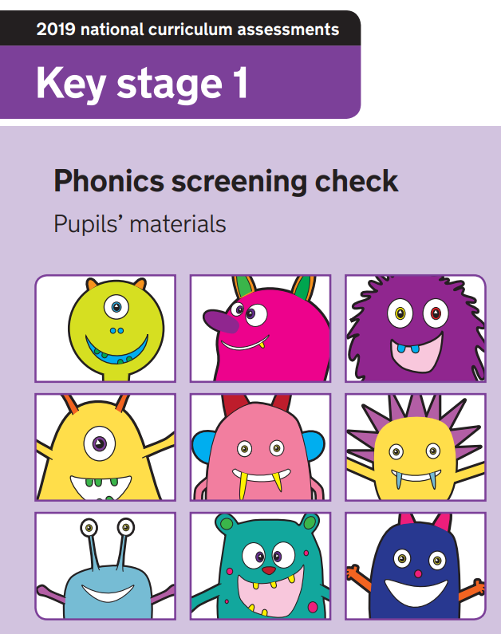
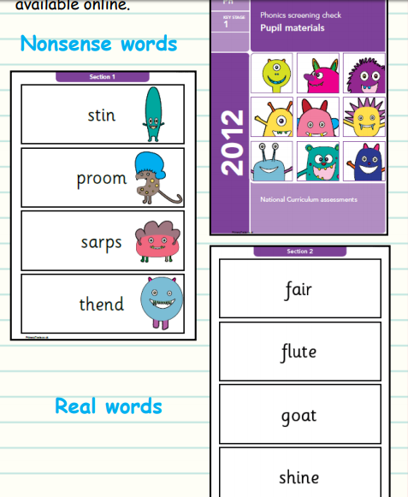
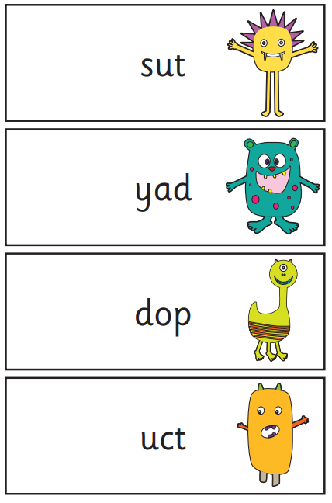
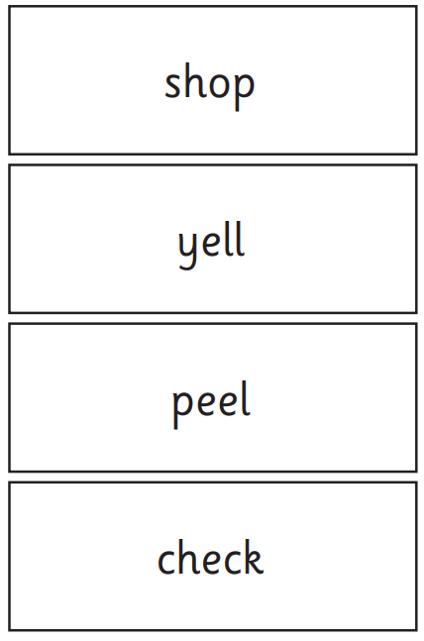
Sample materials are available on the education.gov.uk website. Here are some examples from the 2019 Phonics Screening Test.
All papers from previous years are online.

Slide 7
What skills do children need to meet the standard of the phonics screening check?
All children need to be able to identify sounds associated with different letters, and letter combinations, and then blend these sounds together to correctly say the word on the page.
The same skill is needed whether the word is a real word or a non-word. The words gradually get harder through the check as the combinations of letters become more complicated.
Children will also need to recognise ‘alternative’ sounds in real words, such as ‘y’ in the word happy having the pronunciation ‘e’.

Slide 8
What happens with the scores?
After the check has taken place in June, schools will be given the ‘pass’ mark.
Schools do not publish data but they inform parents of their child’s score.
Schools use the information to find ways to support the children who do not reach the score and the result will provide teachers with information to help develop the child’s skills in phonics.

Slide 9
Is it stressful?
The assessment is age-appropriate, with children sitting with a teacher who they know. Reading one-to-one with a teacher is a familiar activity for Key Stage 1 children. It should be an enjoyable activity for children and takes no more than a few minutes.

Slide 10
How do we teach phonics?
Every day, children learn new sounds, and review previous sounds and words.
They apply what they’ve been taught by reading words containing the sounds they know in matched decodable books and other texts.

Slide 11
How can I help at home?
Practice a mix of real and ‘alien words’

Slide 12
Examples of alien words

Slide 13
Your child’s scores will be reported to you by the end of the summer term. This will include whether or not your child has met the expected standard to ensure you are aware of your child’s progress in developing phonics decoding skills. If your child has not met the expected standard, there will be an outline of the support that will be put in place to help your child progress.

